Slide 1
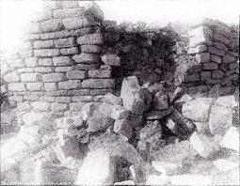
Crying over strewn stones Nehemiah 1:1-11

Slide 2
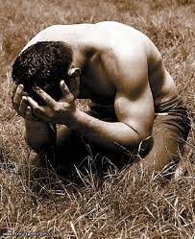
Crying over strewn stones Nehemiah 1:1-11

Slide 3
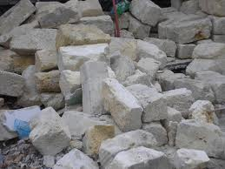
Crying over strewn stones Nehemiah 1:1-11

Slide 4
Crying over strewn stones Nehemiah 1:1-11
Each of you should use whatever gift you have received to serve others, as faithful stewards of God’s grace in its various forms. If anyone speaks, they should do so as one who speaks the very words of God. If anyone serves, they should do so with the strength God provides, so that in all things God may be praised through Jesus Christ. To him be the glory and the power for ever and ever. Amen. (1 Peter 4:10-11).

Slide 5
Crying over strewn stones Nehemiah 1:1-11
1. The person God uses has a burden for his people
2. The person God uses has a vision for his purpose
3. The person God uses has a commitment to his purpose

Slide 6
Crying over strewn stones Nehemiah 1:1-11
The person God uses has a burden for his people

Slide 7
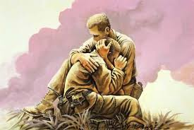
Crying over strewn stones Nehemiah 1:1-11
The person God uses has a burden for his people
Compassionate – he identified with them

Slide 8
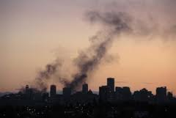
Crying over strewn stones Nehemiah 1:1-11
The person God uses has a burden for his people
Compassionate – he identified with them
Burden increased – root cause = sin

Slide 9
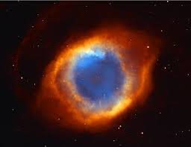
Crying over strewn stones Nehemiah 1:1-11
The person God uses has a burden for his people
Compassionate – he identified with them
Burden increased – root cause = sin
Burden lightened – awesome God

Slide 10
Crying over strewn stones Nehemiah 1:1-11
The person God uses has a burden for his people
Compassionate – he identified with them
Burden increased – root cause = sin
Burden lightened – awesome nature of God
Reaction?
Don’t let immensity of task cause paralysis

Slide 11
Crying over strewn stones Nehemiah 1:1-11
The person God uses has a burden for his people
Compassionate – he identified with them
Burden increased – root cause = sin
Burden lightened – awesome nature of God
Reaction?
Don’t let immensity of task cause paralysis
Don’t commit simply on basis of need

Slide 12
Crying over strewn stones Nehemiah 1:1-11
The person God uses has a burden for his people
Compassionate – he identified with them
Burden increased – root cause = sin
Burden lightened – awesome nature of God
Reaction?
Don’t let immensity of task cause paralysis
Don’t commit simply on basis of need
If no burden – why not?

Slide 13
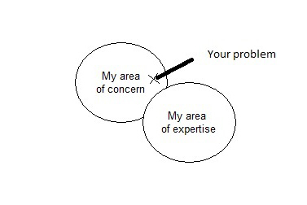
Crying over strewn stones Nehemiah 1:1-11
The person God uses has a burden for his people
The person God uses has a vision for His purpose

Slide 14
Crying over strewn stones Nehemiah 1:1-11
The person God uses has a burden for his people
The person God uses has a vision for His purpose
“I will build my church, and the gates of Hades will not overcome it” (Mat 16:18)

Slide 15
Crying over strewn stones Nehemiah 1:1-11
The person God uses has a burden for his people
The person God uses has a vision for His purpose
For he chose us in him before the creation of the world to be holy and blameless in his sight…in order that we, who were the first to put our hope in Christ, might be for the praise of his glory (Ephesians 1:4,12)

Slide 16
Crying over strewn stones Nehemiah 1:1-11
The person God uses has a burden for his people
The person God uses has a vision for His purpose
What is the chief end of man?
The chief end of man is to glorify God and to enjoy him forever
(Westminster Shorter Catechism 1646)

Slide 17
Crying over strewn stones Nehemiah 1:1-11
The person God uses has a burden for his people
The person God uses has a vision for His purpose
Among the gods there is none like you, Lord; no deeds can compare with yours. All the nations you have made will come and worship before you, Lord; they will bring glory to your name. For you are great and do marvellous deeds; you alone are God. Ps.86:8-10
‘You are worthy, our Lord and God, to receive glory and honour and power, for you created all things, and by your will they were created and have their being.’ Rev 4:11

Slide 18
Crying over strewn stones Nehemiah 1:1-11
The person God uses has a burden for his people
The person God uses has a vision for His purpose
The person God uses has a commitment to His purpose

Slide 19
Crying over strewn stones Nehemiah 1:1-11
The person God uses has a burden for his people
The person God uses has a vision for His purpose
The person God uses has a commitment to His purpose
Nehemiah’s sacrifice for God’s sake
Cup bearer

Slide 20
Crying over strewn stones Nehemiah 1:1-11
The person God uses has a burden for his people
The person God uses has a vision for His purpose
The person God uses has a commitment to His purpose
Nehemiah’s sacrifice for God’s sake
Cup bearer
“And Achiacharus entreating for me, I returned to Nineveh. Now Achiacharus was cupbearer, and keeper of the signet, and steward, and overseer of the accounts: and Sarchedonus appointed him next unto him: and he was my brother’s son” (Tobit 1:22).

Slide 21
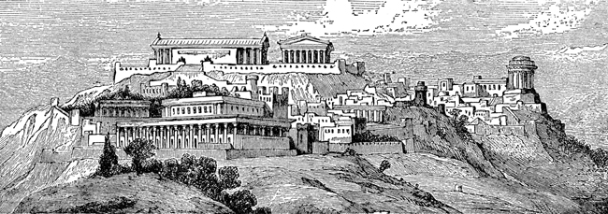
Crying over strewn stones Nehemiah 1:1-11
The person God uses has a burden for his people
The person God uses has a vision for His purpose
The person God uses has a commitment to His purpose
Nehemiah’s sacrifice for God’s sake
Cup bearer
Winter palace at Susa

Slide 22
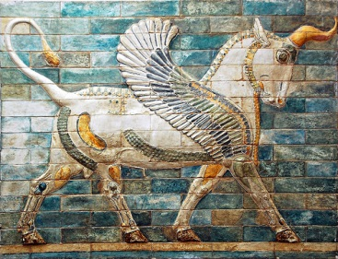
Crying over strewn stones Nehemiah 1:1-11
The person God uses has a burden for his people
The person God uses has a vision for His purpose
The person God uses has a commitment to His purpose
Nehemiah’s sacrifice for God’s sake
Cup bearer
Winter palace at Susa

Slide 23
Crying over strewn stones Nehemiah 1:1-11
The person God uses has a burden for his people
The person God uses has a vision for His purpose
The person God uses has a commitment to His purpose
Nehemiah’s sacrifice for God’s sake
Hearing of distress, was it possible to remain happy?

Slide 24
Crying over strewn stones Nehemiah 1:1-11
The person God uses has a burden for his people
The person God uses has a vision for His purpose
The person God uses has a commitment to His purpose
Nehemiah’s sacrifice for God’s sake
Hearing of distress, was it possible to remain happy?
Easy decision to make – to abandon old life?

Slide 25
Crying over strewn stones Nehemiah 1:1-11
The person God uses has a burden for his people
The person God uses has a vision for His purpose
The person God uses has a commitment to His purpose
Nehemiah’s sacrifice for God’s sake
Nehemiah prepared to face and overcome obstacles for God’s purpose

Slide 26
Crying over strewn stones Nehemiah 1:1-11
The person God uses has a burden for his people
The person God uses has a vision for His purpose
The person God uses has a commitment to His purpose
Nehemiah’s sacrifice for God’s sake
Nehemiah prepared to face and overcome obstacles for God’s purpose
Lessons for today:
If we seek to serve God, we too will face setbacks

Slide 27
Crying over strewn stones Nehemiah 1:1-11
The person God uses has a burden for his people
The person God uses has a vision for His purpose
The person God uses has a commitment to His purpose
Nehemiah’s sacrifice for God’s sake
Nehemiah prepared to face and overcome obstacles for God’s purpose
Lessons for today:
If we seek to serve God, we too will face setbacks
If we seek to serve God, we need commitment

Slide 28
Crying over strewn stones Nehemiah 1:1-11
The person God uses has a burden for his people
The person God uses has a vision for His purpose
The person God uses has a commitment to His purpose
Nehemiah’s sacrifice for God’s sake
Nehemiah prepared to face and overcome obstacles for God’s purpose
Lessons for today:
If we seek to serve God, we too will face setbacks
If we seek to serve God, we need commitment
Learning to hear and obey takes time and courage

Slide 29
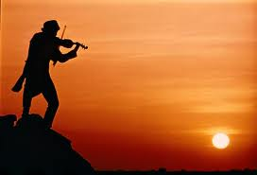
Crying over strewn stones Nehemiah 1:1-11
The person God uses has a burden for his people
The person God uses has a vision for His purpose
The person God uses has a commitment to His purpose
Nehemiah’s sacrifice for God’s sake
Nehemiah prepared to face and overcome obstacles for God’s purpose
Lessons for today:
If we seek to serve God, we too will face setbacks
If we seek to serve God, we need commitment
Learning to hear and obey takes time and courage

